Slide 1
Welcome to
Mrs. Seroyer’s Classroom
Procedures and Guidelines

Slide 2
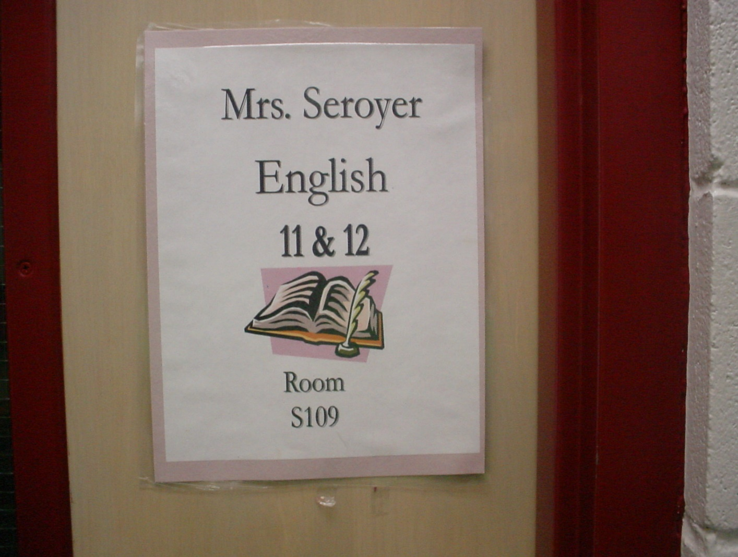
Am I in the right room?
Notes:
Students want to be cool above everything else! It is the ultimate embarrassment for them to walk into the right room.
--A student was standing in front of my door after lunch one day. I asked him if the door was locked because I didn’t remember locking it. He said “I don’t know! I didn’t want to try and get embarrassed if it was locked!”

Slide 3
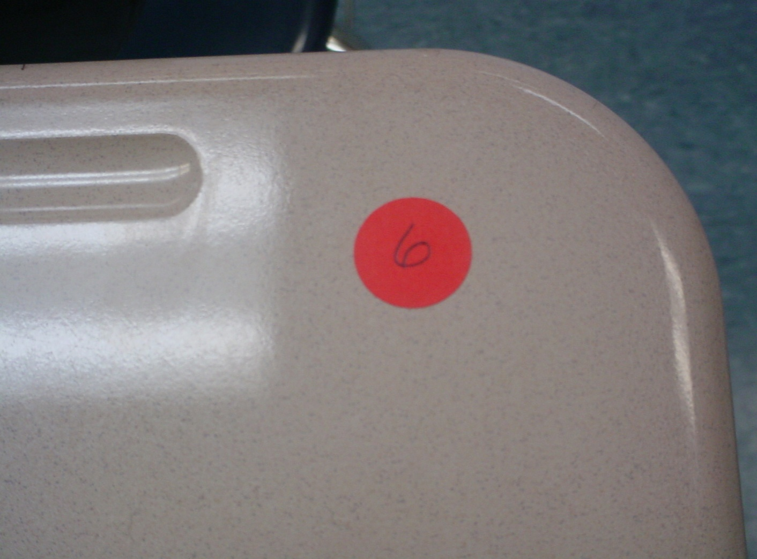
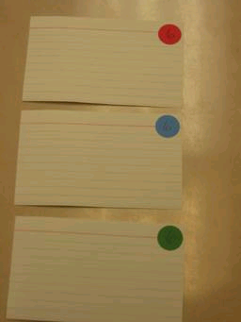
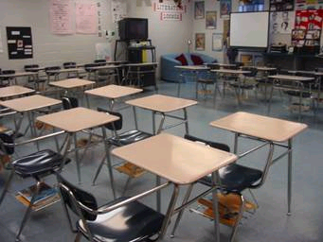
Where am I supposed to sit?
Notes:
This eliminates the possibility of the shy student having to float around the room until he/she finds a place that has not already been occupied by a group of long time friends.
--I also keeps the chatty best friends away from each other.
--

Slide 4
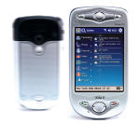
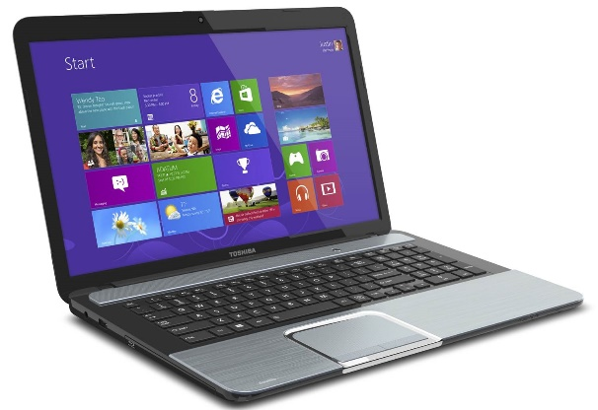



Who is this teacher as a person?
Notes:
Things that I enjoy:
--Reading
--Talking to family and friends
--Technology!!
--Computers
--Book
--Students enjoy knowing that you are a REAL person! Sharing this type of information breaks down the invisible wall between the teacher and the student. It lets them know that you are a regular person who enjoys regular things outside of school.

Slide 5
Will this teacher treat me fairly?
Yes,
Always!

Slide 6







What will I be doing this year?

Slide 7
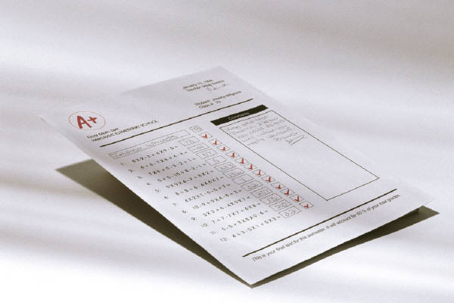
How will I be graded?

Slide 8
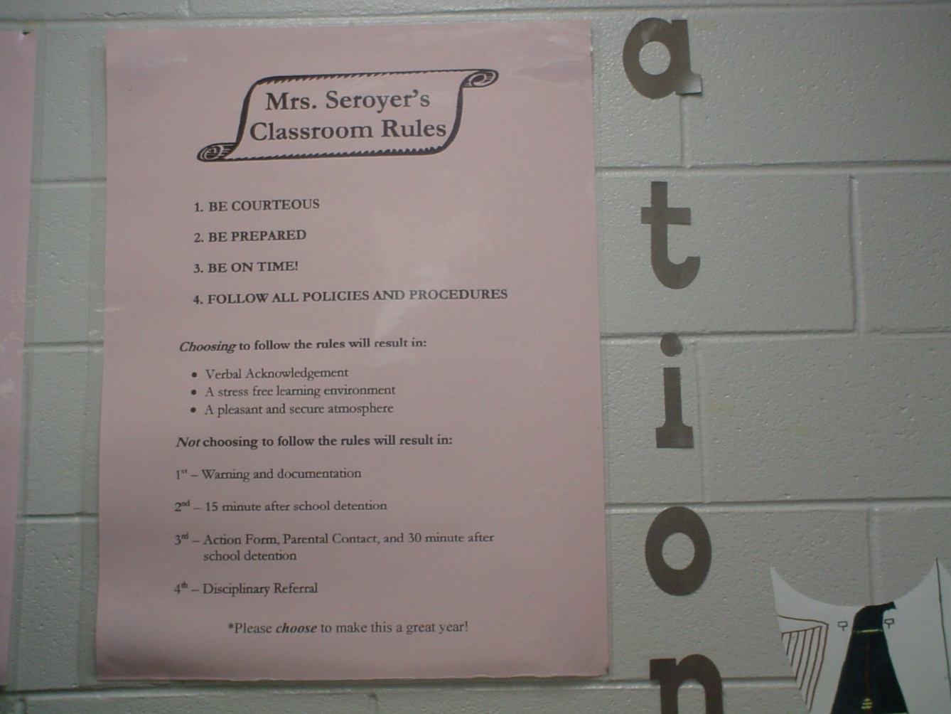
What are the rules in this classroom?

Slide 9
Mrs. Seroyer’s
Classroom Contract
Guidelines
Procedures

Slide 10
Guideline #1
Be in your assigned seat and working on the assigned bellwork when the tardy bell rings.

Slide 11


Slide 12
Guideline #2
Bring ALL books and materials to class and take them with you when you leave.

Slide 13
Guideline #3
Follow directions the first time they are given.

Slide 14
Guideline #4
Treat each person in this room with respect and dignity.

Slide 15
Guideline #5
Follow all procedures and policies as outlined in the BJHS and Madison City Schools handbooks.

Slide 16
Special Guideline
This classroom is a “No Whining Zone”. That means that there will be no whining, for ANY reason.
Everything that I do is in your best interest, so please respect the “No Whining Zone” this semester.

Slide 17
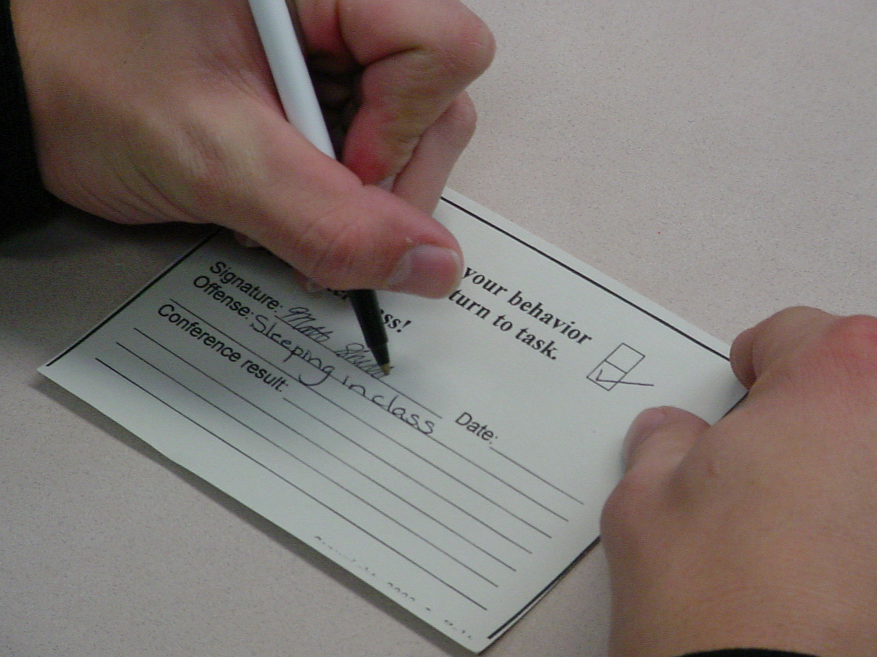
Guideline Infraction Notice

Slide 18
Guideline Infraction Notice
Read it
Sign it
Keep it until the end
of class

Slide 19
Following Guidelines will result in . .
Verbal acknowledgement
A stress-free learning environment
A pleasant and orderly classroom atmosphere

Slide 20
Not Following
Guidelines will result in . . .
1st
  Warning and documentation
2nd
  Action Plan, Parental Contact, and 30 minute after school detention
    Fridays Only!!
3rd
  Disciplinary Referral

Slide 21
Mrs. Seroyer’s Action Plan
What’s the problem?
2. What’s causing the problem?
(Please list the factors)
3. What plan will you use to solve the problem?
________________
Date
_______________________ ______________________
Student’s Signature Parent/Guardian Signature

Slide 22
Severe Clause
Any student who uses profanity, fights, damages school property (this includes the property of the teacher and other students), or is disrespectful (as defined by the teacher) will be sent to the office IMMEDIATELY.

Slide 23
Classroom Procedures
Explain, Rehearse, Reinforce!

Slide 24
Entering the Room
Please enter quietly.
Have a seat.
Take out your materials.
Review the agenda.
Begin bellwork assignment.

Slide 25
When you are tardy . . .
Enter quietly.
Excused: Place excuse in
the basket on my desk.
Unexcused: Sign detention
list on top of file cabinet.
Have a seat and take out
your materials.

Slide 26
Getting Your Attention
I will . . .
Stand in front of the class.
Raise my hand.
Wait for everyone to be
quiet.
Begin speaking.

Slide 27
Paper Heading
MLA Format
  plus unique number
    “Successful Teaching” newspaper p. 8
Place on all homework assignments
Notes:
**Copy of “Successful Teaching”
--Thank you Rosemary Wong! This is a life saver!
--Thank you Mrs. Wong! The unique number paper grading system has saved me hours of valuable time!
--Students have told me that they wish all teachers would agree on one heading. It is very confusing for them.

Slide 28
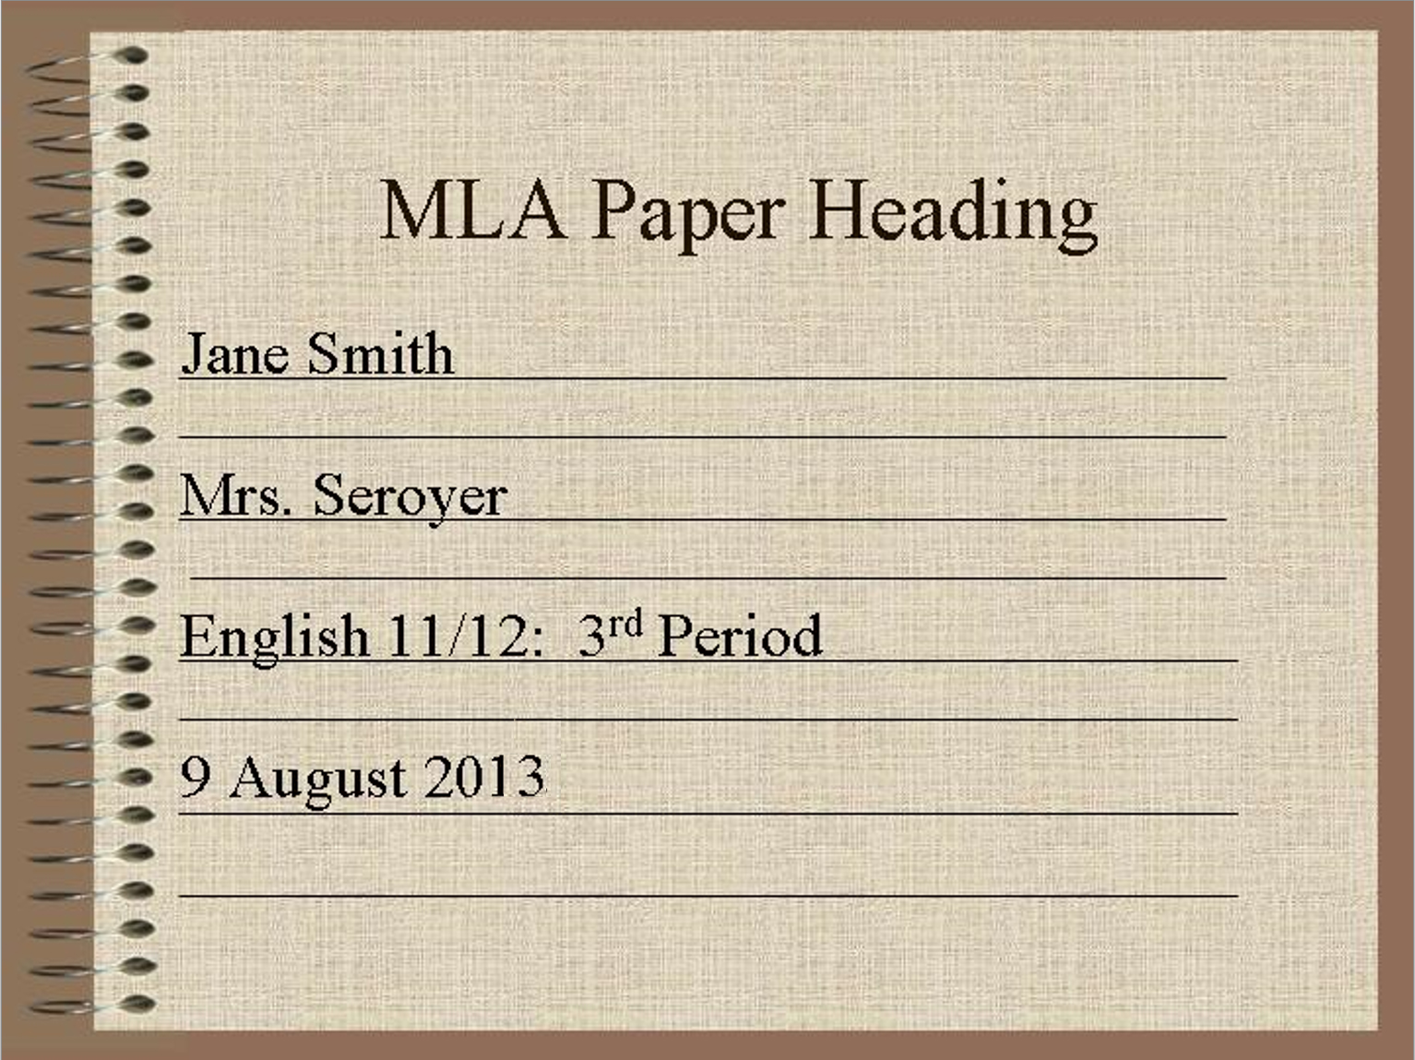

Slide 29
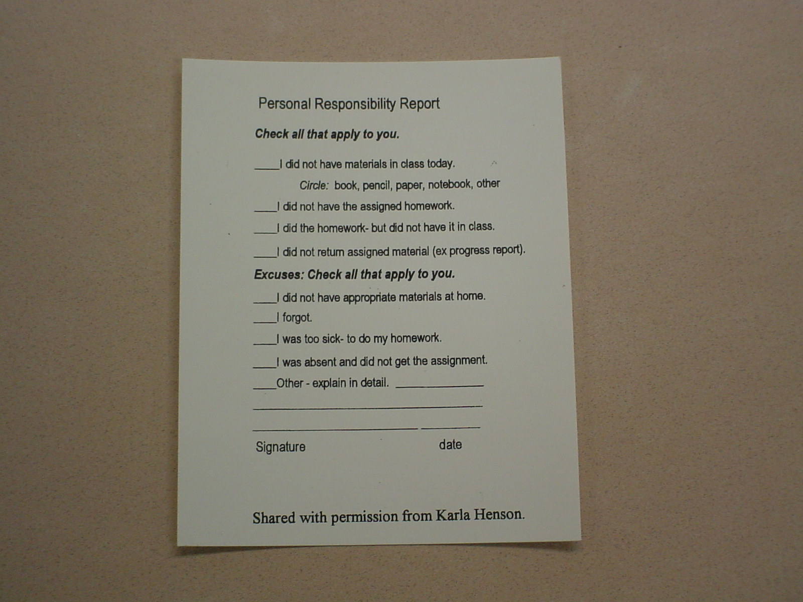
Student Responsibility Card

Slide 30
Student Responsibility Card
This is for students who do not have the assigned homework.
Fill it out.
Sign and date it.
Turn it in with the homework
papers.

Slide 31
Date: _____________________________
Printed Name:_______________________
Class Section:_______________________
You’ve been Pink-Slipped!
  Completing your homework or assignment is your responsibility as a student.
  Missing Assignment: ____________________________________________
  I do not have my homework today because:
  _____ I did the assigned homework, but I did not bring it to class.
  _____ I chose not to do my homework.
  _____ I forgot to do my homework.
  _____ I did not have the appropriate materials at home.
  _____ Other—please explain below.
  ______________________________________________________________________________________________________________________________________________________________________________________________________
  Signature _______________________________________

Slide 32
Finish Classwork Early
“What do I do next?”

Slide 33
Activities
Work on unfinished English assignments.
Read your “choice” novel.
Work on your poetry response.
Review vocabulary words.
Start working on tonight’s homework.

Slide 34
After an Excused Absence
Go to the homework notebook.
Copy the homework.
Retrieve any handouts.
Sign the notebook.
Make-up work for unexcused
absences is not available.
Make-up tests: Wed. @ 7a.m. in the AV Room

Slide 35
Scheduled Check Out
Please let me know as you enter the classroom.
  I will be at the door.
Quietly raise your hand to get my attention.
Pack your materials and leave at the scheduled time.
If it is an emergency, quickly get my attention and I will assist you.

Slide 36
Turning in Papers
Place your paper on the desk next to you.
  Left side
If/When you receive a paper, place yours on top and continue passing the stack to your left.
I will come by and collect all stacks.

Slide 37
Classroom Discussions
PLEASE participate.
I want to hear what you have to say.
Make all questions and comments relevant to the current discussion.
If your question is off the topic, write it down and ask later.

Slide 38
Moving Around the Room
You must ask permission.
Do not ask during a classroom discussion unless it is an emergency.

Slide 39
Class Dismissal
The teacher dismisses you, not the bell.
Do not start packing up prior to the bell.
Wait until the teacher finishes and officially dismisses you with
“Have a nice day!”

Slide 40
“Special” Procedures
These will be introduced on an “as needed” basis.
Library/Media Center
Distance Learning Lab
  Video Conferences
Special guests
Progress Reports
Working Cooperatively
Fire Drill
Intercom Announcements
Assemblies
Substitute Teacher
Notes:
Assignment: Does music bother anyone?
Turning in Papers: p.190
MLA: Double space for word processed papers
Questions: PLEASE ask. No such thing as stupid questions. If you don’t understand, please let me know.
Announcements: Complete silence. Resume work.

Slide 41
“I truly believe in your potential and I know that you have the ability to succeed!
Have an awesome year!”
– Mrs. Seroyer

